Slide 1
WEBU MVA 2019
TV Response curves

Slide 2
What’s the “right” level of investment?
CONCEPTUAL Volume and Profit Response to Media
Max BC
Invest here to maximize Volume
Avoid investing here, Negative ROI
Investment
Low to high →
Invest at least to here to maximize Brand Contribution
Notes:
[We’ve looked at how effective the different media channels are at driving volume across brands. For instance, TV is disproportionately more effective than other channels. We spend a lot on TV to drive volume but can we spend more?]
1. In order to determine the right level of investment on a media channel, it is important to look at the Response Curve & Profit Curve. This is a conceptual representation.
2. Let’s first look at the Response Curve, the black line - As you increase your spend on a media channel, let’s say TV, it will continue to drive incremental volume at a diminishing rate. [For instance, hearing about the Euro Cup a 10th time will have less impact on a single consumer’s buying behavior than the first time she heard about it] The curve eventually reach as saturation point and if you continue spending beyond the saturation point, you will barely move the needle on incremental volume. [Does the response curve first increase at an increasing rate and then increase at a diminishing rate?]
3. Now, let’s look at Profit Curve – As you increase you spend on TV, you will see an increase in Profits or Brand Contribution up to a certain point at which it is maximized and then the profits will start to diminish and eventually enter negative territory.
4. The range between the two points is the optimum range. If your objective is to maximize profits, then the GRP support at which you maximize profit is the optimal level of support on that media activity. On the other hand, if your objective is to maximize incremental volume or revenue, then the GRP support at which you maximize incremental volume is the optimum level of support.

Slide 3
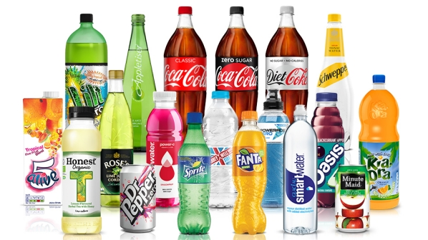
There is margin to increase profitability by increasing GRPs in Coca-Cola Masterbrand (Coca Cola Regular & Coca Cola Zero) campaigns
2019. GRPs and incremental profit (‘000 EUR)
Current GRPS
 | Master Brand | Coca-Cola Light | Fanta | Sprite
Current Grps | 3,627 | 850 | 894 | 833
Weeks Aired | 39 | 14 | 11 | 9
Avg. Weekly GRPs | 93 | 61 | 81 | 93
Optimal GRPs | 12,000 | - | - | -
Opt. Weekly GRPs | 308 | - | - | -
Uplift UC/GRP | 1,520 | 55 | 189 | 41
SYS GP/UC 2019 | 2.69 | 2.74 | 1.79 | 1.58
Cost/GRP 2019 | 1.1 | 1.5 | 1.6 | 0.8
ROI (ST) | 3.59 | 0.10 | 0.22 | 0.12
ROI (ST+LT) | 5.63 | 0.14 | 0.32 | 0.08
Optimal GRPS

Slide 4
Coke Masterbrand is close to optimal level for increase in profitability
GRPs and incremental profit (‘000 GBP)
Profit Curves
Current GRPS
 | Coca-Cola MB | Diet Coke
Current Grps | 2,477 | 1,100
Avg. Weekly Grps | 75 | 65
Weeks Aired | 33 | 17
Optimal Grps | 2,200 | -
Opt. Weekly Grps | 67 | -
Uplift UC/GRP | 1,368 | 678
SYS GP/UC 2019 | 2.24 | 2.43
Cost/ ‘000 GRP 2019 | 3.82 | 3.51
ROI (ST) | $ 0.76 | $ 0.47
ROI (ST+LT) | $ 1.19 | $ 0.80
Optimal GRPS

Slide 5
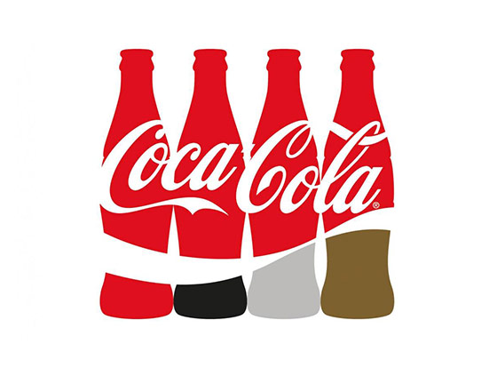
There is margin to increase TV profitability in Coca-Cola MB
GRPs and incremental profit (‘000 EUR)
Current GRPS
 | Coke TM
Current Grps | 12,963
Avg. Weekly Grps | 259
Weeks Aired | 50
Optimal Grps | 14,600
Opt. Weekly Grps | 292
Uplift UC/GRP | 787
SYS GP/UC 2018 | 3.48
Cost/000’ GRP 2019 | $ 1.37
ROI (ST) | $ 1.91
ROI (ST+LT) | $ 4.47
Optimal GRPS

Slide 6
There is margin to reduce Aquarius GRPs to achieve maximum profitability
GRPs and incremental profit (‘000 EUR)
Profit Curves
Current GRPS
 | Fanta TM | Aquarius TM | Nestea TM
Current Grps | 4,535 | 6,627 | 2,661
Avg. Weekly Grps | 239 | 288 | 222
Weeks Aired | 19 | 23 | 12
Optimal Grps | - | 4,800 | -
Opt. Weekly Grps | - | 209 | -
Uplift UC/GRP | 266 | 147 | 97
SYS GP/UC 2019 | 1.69 | 4.12 | 4.06
Cost/000’ GRP 2019 | 1.00 | 1.15 | 1.10
ROI (ST) | $ 0.45 | $ 0.52 | $ 0.36
ROI (ST+LT) | $ 0.90 | $ 1.01 | $ 0.73
Optimal GRPS

Slide 7
Thank you

